Slide 1
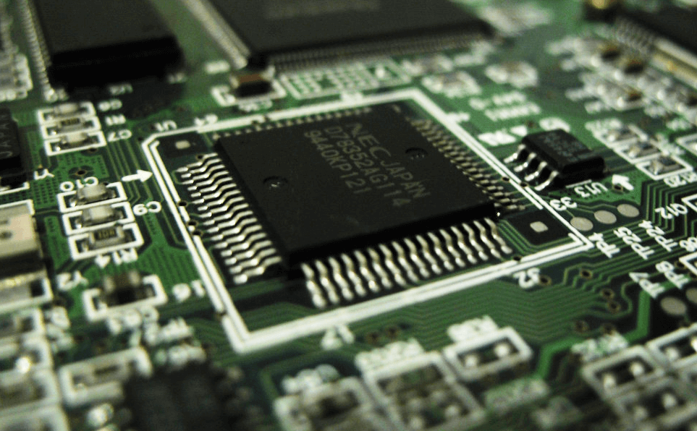
Introduction to Microprocessor Based Systems Design
Dr. Manju Khurana
Assistant Professor, CSED
TIET, Patiala
manju.khurana@thapar.edu

Slide 2
Microprocessor
Introduction to Microprocessor Based Systems Design
Microprocessor is a hardware component of computer, and it works as brain of the computer system as well as use in computer because without using microprocessor, Computer like as plastic box. Microprocessor shape as a small chip that is made by silicon and it has to responsible to all functions of central processing unit.
Microprocessor meaning is a control unit of computer because it is able to manage all various Arithmetic Logical Unit (ALU) operations. Microprocessor can capable to execute other operations such as computational activities like as addition/subtraction, internal processing, device terminals communication, and I/O management.

Slide 3
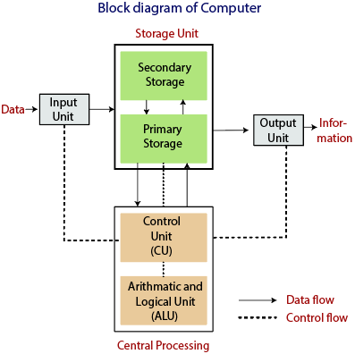
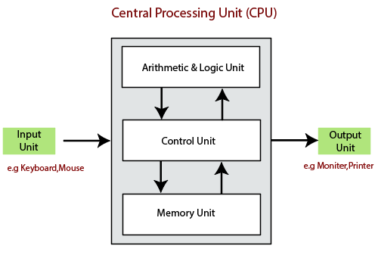
Block Diagram of Digital Computer
Introduction to Microprocessor Based Systems Design
3

Slide 4
Block Diagram of Digital Computer
Introduction to Microprocessor Based Systems Design
The data is entered through input devices such as the keyboard, mouse, etc. This set of instruction is processed by the CPU after getting the input by the user, and then the computer system produces the output. The computer can show the output with the help of output devices to the user, such as monitor, printer, etc.
CPU (Central Processing Unit)
Storage Unit
ALU (Arithmetic Logic Unit)
Control Unit
The computer system is nothing without the Central processing Unit so, it is also known as the brain or heat of computer. The CPU is an electronic hardware device which can perform different types of operations such as arithmetic and logical operation.
4

Slide 5
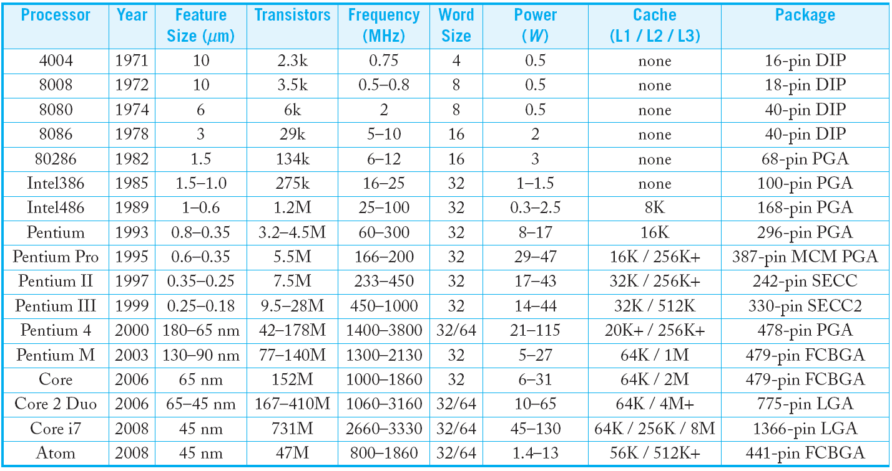
Evolution of Microprocessors
Introduction to Microprocessor Based Systems Design
5

Slide 6
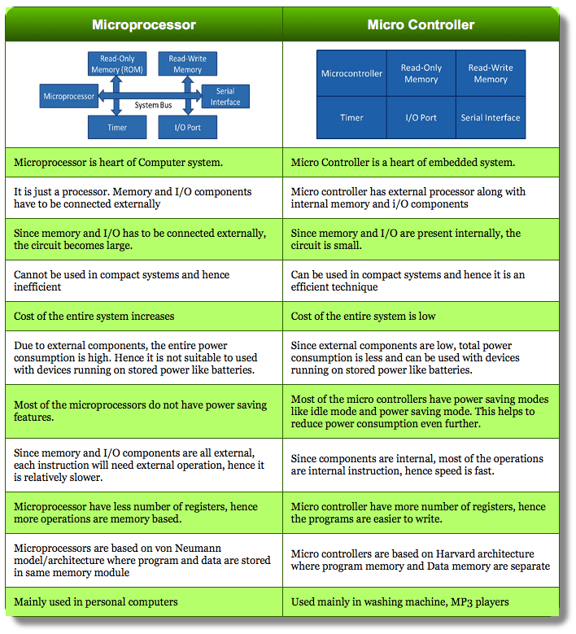
Introduction to Microprocessor Based Systems Design

Slide 7
Syllabus
Introduction to Microprocessor Based Systems Design
8085 Microprocessor
8086 Microprocessor
Interfacing
ARM
7

Slide 8
Books
Introduction to Microprocessor Based Systems Design
Gaonkar R., Microprocessor Architecture, Programming and Applications with the 8085, Penram International Publishing India Pvt. Ltd. (2013) 6th ed.
Hall V. D. and Rao S., Microprocessor and Its Interfacing, Tata McGraw Hill Publishing Company (2012) 3rd ed.
Furber S., ARM System on Chip Architecture, Pearson Education (2000) 2nd Edition.
Liu Y. and Gibson A. G., Microcomputer Systems: The 8086/8088 Family Architecture Programming and Design, Pearson (2006) 2nd ed.
Sloss N. A., Symes D. and Wright C., ARM System Developer’s Guide, Morgan Kaufmann publications (2004).
8

Slide 9


